Slide 1
Coursera Capstone Project – IBM Data Science Certification
Sofyan Assauri
2020, May

Slide 2
Report Content
Introduction – The business problem to be solved and who may be interested
Data – Data requirements and source needed to solve the business problem
Methodology – Data processing, explanatory data analysis, statistical testing performed
Result – The result and finding of answer
Discussion – Discussion of observation noted and any recommendation
Conclusion – Answer choosen and conclusions

Slide 3
Introduction
Scenario and background
Jakarta is one of the largest metropolises in the world where over 10,7 million people live and it has a population density of 4.282 people per square kilometer. As a resident of this city, I decided to use Jakarta in my project. The city is divided into 42 districts in total.
II. Problem to be resolved
As you can see from the figures, Jakarta is a city with a high population and population density. Being such a crowded city leads the owners of shops and social sharing places in the city where the population is dense. When we think of it by the investor, we expect from them to prefer the districts where there is a lower real estate cost and the type of business they want to install is less intense. If we think of the city residents, they may want to choose the regions where real estate values are lower, too. At the same time, they may want to choose the district according to the social places density. However, it is difficult to obtain information that will guide investors in this direction, nowadays.
When we consider all these problems, we can create a map and information chart where the real estate index is placed on Istanbul and each district is clustered according to the venue density.
III. Interested Audience
I believe with the methodology, data, and tools used in this project is relevant for an investor who want to expand their business. The use of Foursquare data, mapping techniques, and data analysis will help resolve the questions. This project is also a good practical case for a person developing Data Science skill.

Slide 4
Data
To consider the problem we can list the datas as below:
I used Forsquare API to get the most common venues of given Borough of Jakarta.
2018 per square meter Nilai Jual Objek Pajak (NJOP) or land tax valuation averages for each Borough of Jakarta from Jakarta Tax Office.
Google Map, ‘Search Nearby’ option to get the center coordinates of the each Borough.

Slide 5
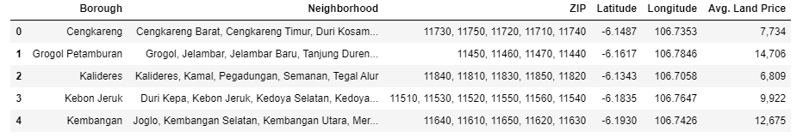
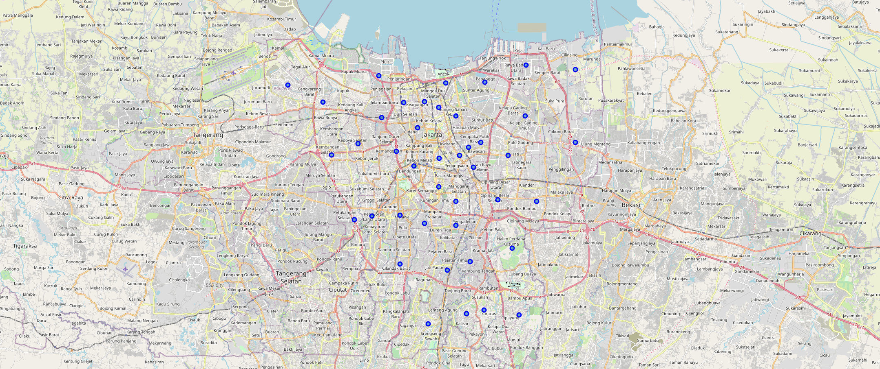
Methodology 1/6
My master data which has the main components Borough, Neighborhood, ZIP, Average Land Price, Latitude and Longitude informations of the city.
Python folium library to visualize geographic details of Jakarta and its boroughs and I created a map of Jakarta with boroughs superimposed on top. I used latitude and longitude values to get the visual as below:

Slide 6
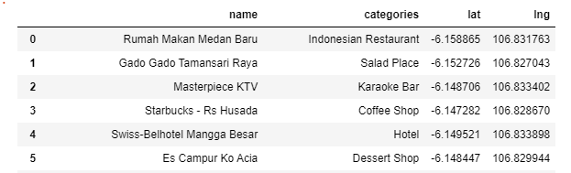
Methodology 2/6
I utilized the Foursquare API to explore the boroughs and segment them. I designed the limit as 100 venue and the radius 1000 meter for each borough from their given latitude and longitude informations. Here is a head of the list Venues name, category, latitude and longitude informations from Forsquare API.
In summary of this data 92 venues were returned by Foursquare. The result doesn’t mean that inquiry run all the possible results in boroughs. Actually, it depends on given Latitude and Longitude informations and here is we just run single Latitude and Longitude pair for each borough. We can increase the possibilities with Neighborhood informations with more Latitude and Longitude informations.

Slide 7
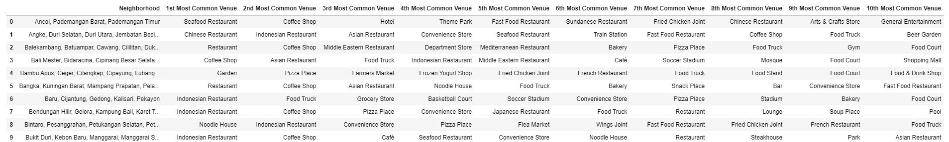
Methodology 3/6
Then I created a table which shows list of top 10 venue category for each borough in below table.
We have some common venue categories in boroughs. In this reason I used unsupervised learning K-means algorithm to cluster the boroughs. K-Means algorithm is one of the most common cluster method of unsupervised learning. Then, I run K-Means to cluster the boroughs into 5 clusters.

Slide 8
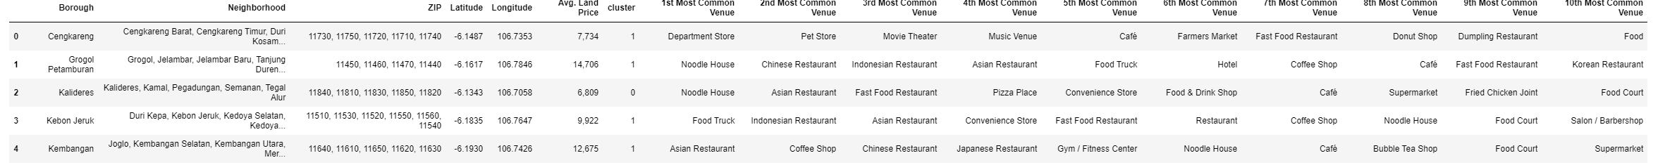
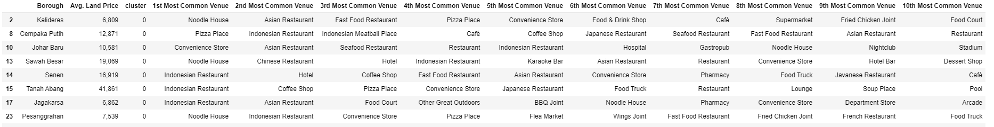
Methodology 4/6
Here is my merged table with cluster labels for each borough.
We can also estimate the number of 1st Most Common Venue in each cluster by understand the Borough through categorization.
Cluster 0
Cluster 1

Slide 9
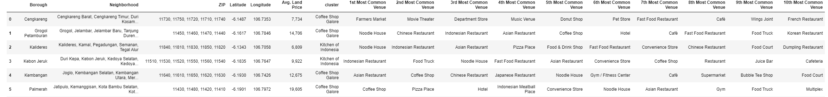
Methodology 5/6
Cluster 2
Cluster 3
Cluster 4
From the categotization above, then I rename the cluster based on common venues available for each Borough, as follows

Slide 10
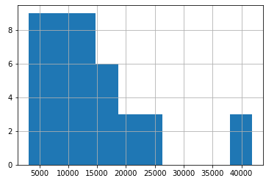
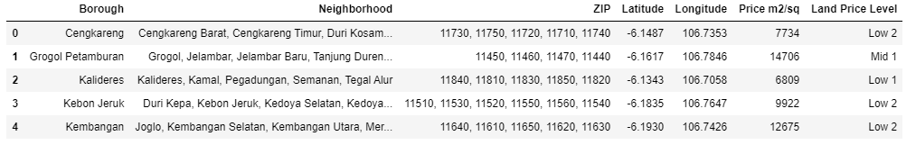
Methodology 6/6
We can also examine that what is the frequency of average land prices in different ranges. Thus, histogram can help to visualization:
As it seems in above histogram, we can define the ranges as below (in thousand IDR)
7000 : “Low 1”, 7000–14000 : “Low 2”, 14000–21000 : “Mid 1”, 21000–280000 : “Mid 2”, 28000-35000 : “Mid 3”, 35000-42000 : “High 1”, 42000 > : “High 2”

Slide 11
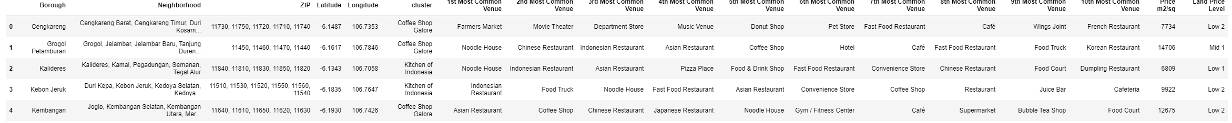
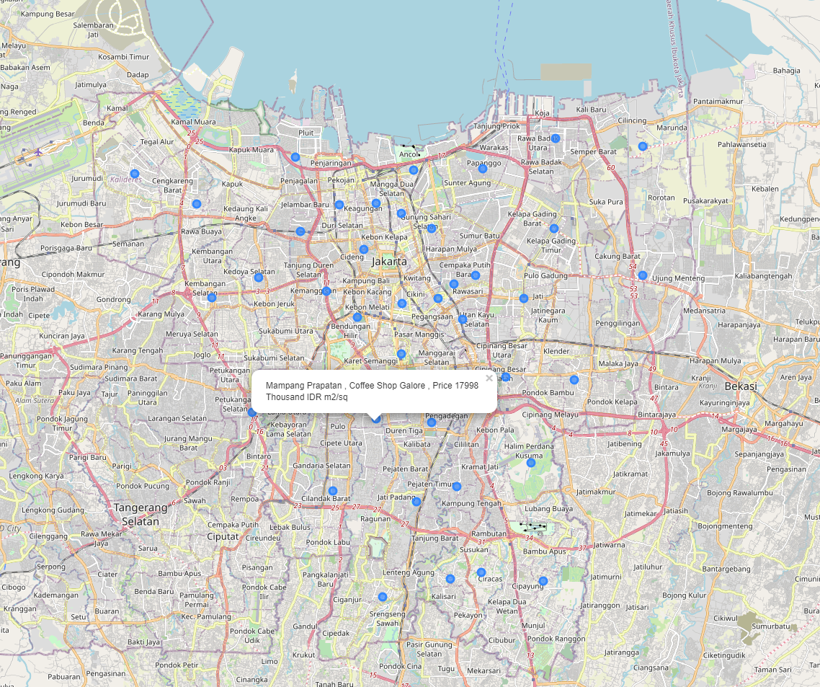
Result
Let’s merge those new variables with related cluster informations in our main master table.
You can now see Join, Labels and Level_labels columns as the last three ones in above table. You can also see a clustered map boroughs of Istanbul in the below.

Slide 12
Discussions
As I mentioned before, Jakarta is a big city with a high population density in a narrow area. The total number of measurements and population densities of the 42 districts in total can vary. As there is such a complexity, very different approaches can be tried in clustering and classification studies. Moreover, it is obvious that not every classification method can yield the same high quality results for this metropol.
I used the Kmeans algorithm as part of this clustering study, I set the optimum k value to 3. I also performed data analysis through this information by adding the coordinates of districts and Average land price averages as static data on GitHub. In future studies, these data can also be accessed dynamically from specific platforms or packages.
I ended the study by visualizing the data and clustering information on the Jakarta map. In future studies, web or telephone applications can be carried out to direct investors.

Slide 13
Discussions
As a result, people are turning to big cities to start a business or work. For this reason, people can achieve better outcomes through their access to the platforms where such information is provided.
Not only for investors but also city managers can manage the city more regularly by using similar data analysis types or platforms.

